Slide 1

MSIX App Attach
By – Vaibhav Singh

Slide 2
Contents
MSIX –
Introduction
File structure
Features
Comparison with its alternatives
MSIX app attach-
Introduction
Features
Necessity of app-attach
Its alternatives
Requirements
Process flow and its Terminologies.
Overview and Configuration in detail
References

Slide 3
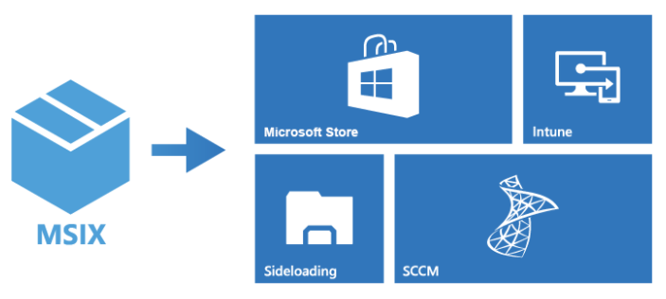
What is MSIX?
MSIX is a next generation Windows app Package format which was introduced in 1st October 2018.
The new packaging format is based on the .msi installer, .appx, installer, App-V, and ClickOnce installers. It keeps the functionality of the existing app installer packages and installation files while enabling new and modern packaging and deployment features to Win32, WPF, and WinForm apps. (application interface/design technologies)
It is a completely new way to handle software packaging which is open source and the technology will work not only on Windows 7 and Windows 10, but also Linux, OSX, iOS and Android.

Slide 4
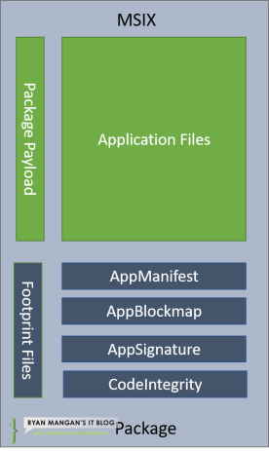
MSIX Package Structure
App Payload – The payload files are the app code files and assets created when building the image, for example, “icon”.
AppxBlockMap.xml – The package block map file is an XML file containing a list of the app’s files, including indexes, cryptographic hashes for each block of data stored in a package. The block file is verified and secured with a digital signature when the package is signed.
AppxManifiest.xml – The package manifest contains the information needed to deploy, display and update the MSIX Application. The information includes Package identity, package dependencies, required capabilities, visual elements and extensible points.(Basic properties of the file)
AppxSignature.p7x – This file is generated when the package is signed. All Packages are required to be signed before you run them (Validated).

Slide 5
Features:
Network bandwidth Optimization – MSIX decreases the network impact by using the 64k block. This is done by using the AppxBlockmap.xml file contained within the MSIX Application package. MSIX has been specifically designed to support cloud and modern systems.
Disk Optimizations – MSIX removes files’ duplication across apps and windows, enabling shared files across applications. The applications are still independent of each other, and updates will not impact any other application that may share a file.
Reliability – MSIX provides a reliable install, and it’s suggested that the success rate is around 99.96% over millions of installs with a Microsoft guaranteed uninstall.
Package existing Windows apps. Use the MSIX Packaging Tool to create an MSIX package for any Windows app, old or new. The MSIX packaging tool streamlines the packaging experience, offering an interactive user interface or command line to convert and package Windows apps.
Apply run time fixes to packaged apps. The Package Support Framework is an open source kit that helps you apply fixes to your existing desktop app when you don't have access to the source code, so that it can run in an MSIX container.
Use MSIX anywhere. With the open source MSIX SDK, MSIX packages are more versatile, and platform independent. The SDK provides all of the APIs needed to verify, validate, and unpack an app package on any platform, including Windows 10 and non-Windows 10 platforms.(SDKs allow programmers to develop apps for a specific platform.) SDK is the acronym for “Software Development Kit

Slide 6
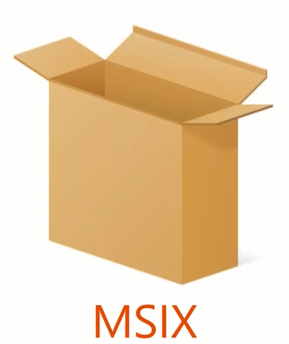
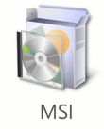


Types of packaging formats in windows
MSIX decreases the network impact by using the 64k block. MSIX has been specifically designed to support cloud and modern systems. It removes files’ duplication across apps and windows, enabling shared files across applications. The applications are still independent of each other, and updates will not impact any other application that may share a file. Success rate is around 99.96% over millions of installs with a Microsoft guaranteed uninstall.
MSI installers are best for simple, possibly unattended, installations. They use a basic install graphical user interface (GUI) that installs or uninstalls the program with no extras or options. The install process won’t detect if the software already exists, or if any components are missing. It may overwrite any files in the install path. This simplicity means a silent, all-defaults install is a breeze for administrators to accomplish.
EXE installers(initial release -31st August 1999) are more versatile than MSI installers, but with the added capability comes complication. This installer can include options for languages, add-ons, detecting previous installations, and more. EXE installers allow for custom install paths and choosing which components to install. Developers can add their own branding to the GUI and incorporate language-specific terms of service or point to a webpage for a welcome message. But this, in turn, makes a silent unattended install much more difficult, and thus less useful in an enterprise situation.
AppX installers are used for Universal Windows Apps and share some of the benefits of MSI installers. They are simple, straight forward installers with few choices given to the end user. Additionally, they allow for an easier upgrade path from older versions of software to newer versions, and they allow for a cleaner uninstall. AppX installers also rely on container technology, so they are isolated from the rest of the operating system for security. Unfortunately, a program written for an MSI or EXE installer had to be rewritten or converted, perhaps with the help of tools, for the AppX package. And AppX packages can only be used with Windows 10, so older versions of Windows are out of luck.

Slide 7
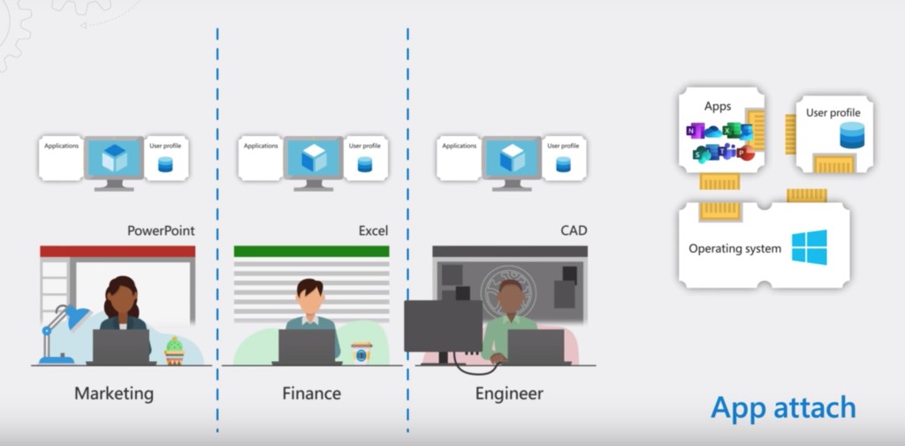
MSIX app attach
MSIX App Attach is Microsoft’s Application layering technology ,designed for WVD which uses the new MSIX package format to separate applications from the core Operating system and deliver applications to users dynamically .
It enables applications to be stored outside a virtual machine. This means that each application can attach itself as and when users need it, which helps keep the image clean, something that Microsoft has been working hard on, for example with FSLogix for profiles or OneDrive for file shares.
It was launched as public preview in December 2020 . The general release of MSIX app attach was came on the 13th of April 2021
Apps that are packaged using MSIX run in a lightweight app container. The MSIX app process and its child processes run inside the container and are isolated using a file system and registry virtualization. All MSIX apps can read the global registry. An MSIX app writes to its own virtual registry and application data folder, and this data will be deleted when the app is uninstalled or reset. Other apps do not have access to the virtual registry or virtual file system of an MSIX app.

Slide 8
Features:
Removes need of Repackaging-It uses streaming technology to optimize bandwidth by only downloading the differences between an existing package and an upgrade.
Creates Separation -The application lives inside a virtual application container which ensures strict isolation between the application and the operating system.
Supports silent installation -Capturing products is performed similarly to MSI packaging. MSIX support converting EXE installers and MSI packages unattended.
OS remains unmarked -Once the app is De-staged ,no trace file is left within the system, like app was never there.
Reduces time it takes for a user to sign in.
Reduces infrastructure requirements and cost.

Slide 9
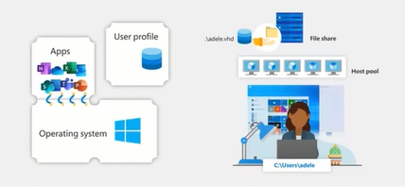
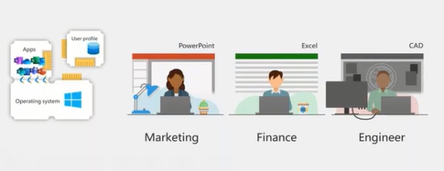
Why MSIX app attach was introduced.
Profile containers get us half-way there.
With FSLogix we have separated the user profile layer from
the virtual machine.
To the user it feels like you are saving and accessing files from a local disk.
But – what about the apps?
In a shared or pooled virtual machine, this is a challenge.
Each user might need a different set of apps.
They can be assigned to a different VM with each logon.

Slide 10
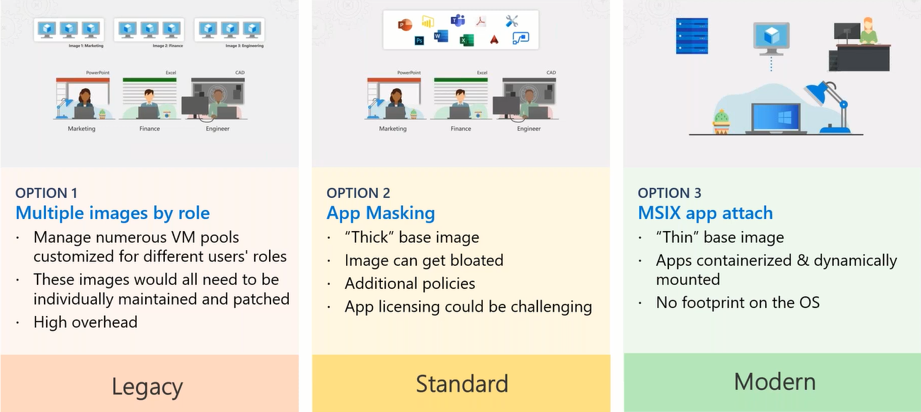
Current options of App delivery

Slide 11
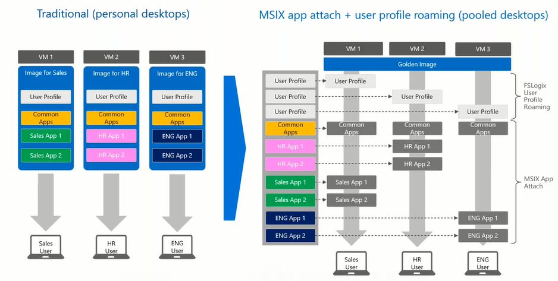
Traditional vs MSIX App attach Image Delivery
Traditional :. Essentially, multiple images are created for departments or user types/categories. This image management method is time-consuming, and you effectively have to manage the applications and windows updates for each image.
MSIX App attach Delivery: As you can see from the diagram, FSlogix profiles are mounted to each virtual machine. You will also note that each VM has the generic (common Applications) Applications deployed on the image (core). You could deploy all App Attach applications; however, in this example, departmental images are separated from the OS . You will see that each different department’s users are presented with specific applications they require. For example, Sales only receive Sales App1 and Sales App2. MSIX App Attach enables you to isolate applications for the required specific user groups in question.

Slide 12
Requirements
Azure Virtual Desktop deployment
Windows 10 single or multi-session (at least build 2004 or the past 19041 Insiders preview release.
Network share (e.g. Azure Files or Azure NetApp Files)
Before you get started, make sure to fill out and submit this form to whitelist MSIX app attach in your Azure subscription.
Your host pool – session host(s) – should be active in the validation environment
The session host VMs that are part of the AVD host pool must have (at least) NTFS read permissions to the share
MSIX packaging tool
MSIX Mgr tool
An internal or external certificate with CN=orgname as required for the MSIX package

Slide 13
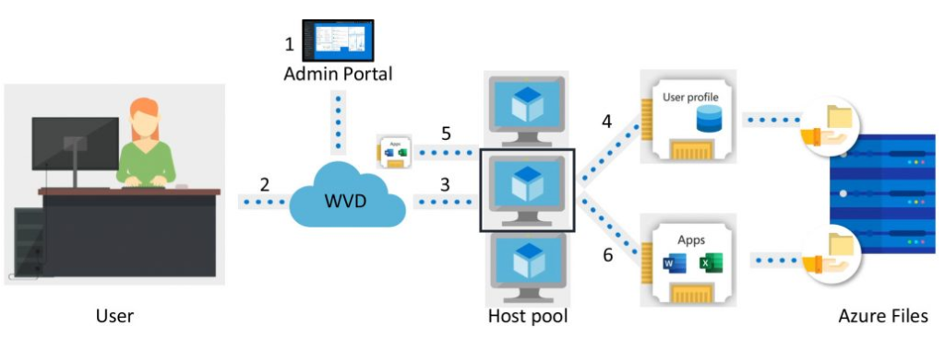
Process flow
The user open’s the “Remote Desktop” Client and enters their credentials, and selects the host pool they have access to.
The process of communicating with the WVD management service (broker etc.) is completed, and a session is assigned to an available Virtual machine within the host pool.
The FSLogix Agent on the session host then requests the user profile from the file share for the user to be Authenticated.
The file share could be Azure Files, Azure Netapp Files or Iaas File server / other.
Once the access to the file share is granted Applications (App Attach) are mounted to the Virtual Machine for that user.

Slide 14
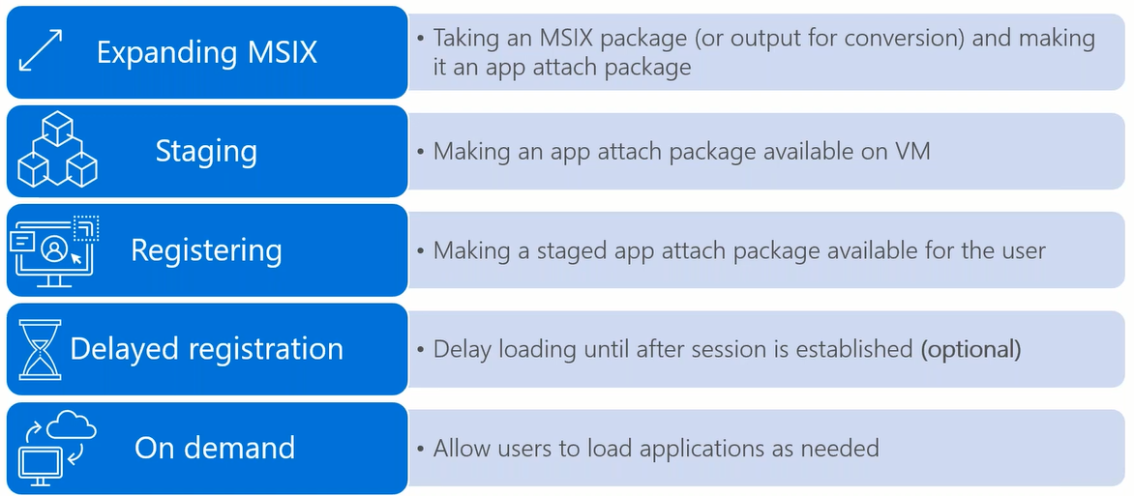
Terminologies
Staging-It involves two steps
1)Mounting the VHD(x) or CIM to the VM.
2)Notifying the OS that the MSIX package is available for registration by mounting the apps to Host pool
Registration- Registeration is per-user basis and explicit registration is required for that user. They are of 2 types
REGULAR REGISTRATION - Application assigned to a user is fully registered. Registration happens during the time the user signs in to the session, which might impact the time it takes for them to start using Windows Virtual Desktop.
DELAYED REGISTRATION (DEFAULT) -Each application assigned to the user is only partially registered which means that the Start menu tile and double-click file associations are registered. It has minimal impact on the time it takes to start using Windows Virtual Desktop as Registration completes only when the user runs the application in the MSIX package.
De-registration -It removes a registered but non-running MSIX package for a user. It happens while the user signs out of their session. During de-registration, MSIX app attach pushes application data specific to the user to the local user profile.
De-stage-It notifies the OS that an MSIX package or application that currently isn't running and isn't staged for any user can be unmounted. This removes all reference to it in the OS.

Slide 15
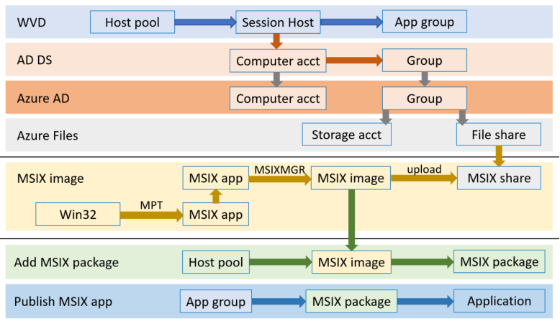
Overview of MSIX app attach setup process
1. WVD host pool with healthy VMs
2. Obtain application packaged as MSIX (aka as MSIX package)
3. Expand MSIX package in MSIX image via the MSIXMGR
4. (Optional) if MSIX package was signed with a no-public certificate
install it in Trusted People on each VM in the host pool
5. Create new or use existing AD DS group in AD DS
6. Add all session hosts computer accounts to the AD DS group
7. VMs must be restarted to pick up membership to the AD DS group
8. Sync the group to Azure AD (this may take up to 30 minutes)
9. Create MSIX share
10. Grant permissions on the MSIX share
a. If using Azure Files for the MSIX share
b. Grant AD DS group RBAC permission on the storage account
c. Grant AD DS group NTFS permissions on the file share
11. Upload MSIX image to MSIX share.
12. Open the WVD host pool and click MSIX packages
13. Click Add and complete Add MSIX package
14. Next open remote app (RAG) or desktop application (DAG) and publish an MSIX application
15. Assign users or user groups to the RAG or DAG

Slide 16
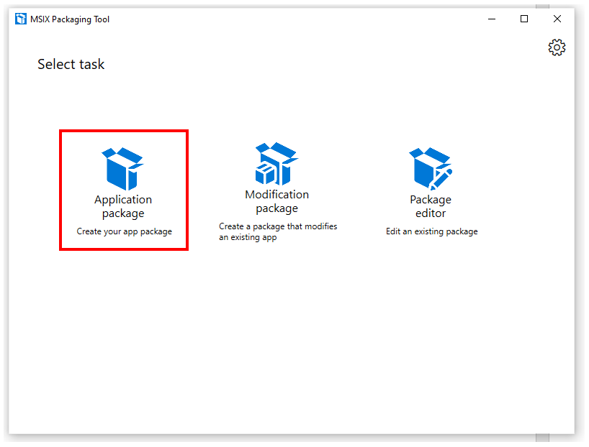
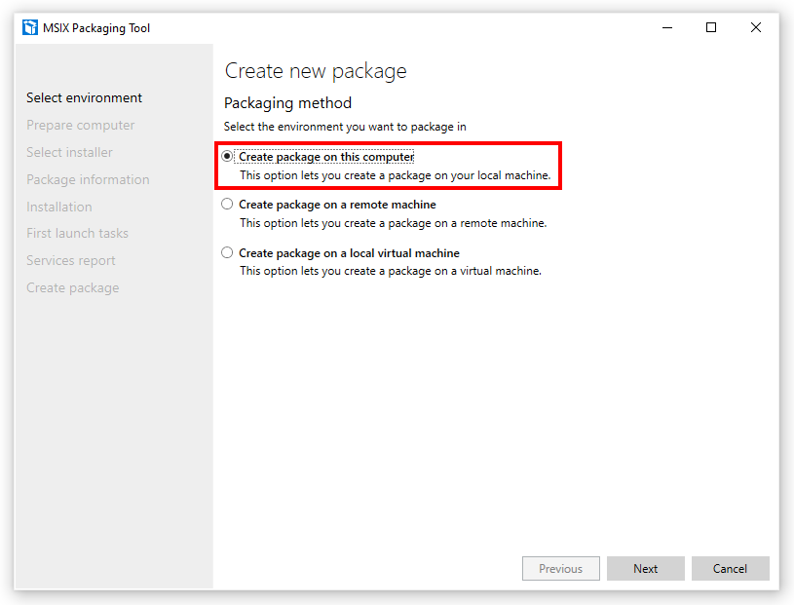
Deploying MSIX app attach
1.Packaging the App
Application package – This can be used to create a package in MSIX format from an application (e.g. msi or exe Installer)
Modification package – This will create a Modification package. Modification package are MSIX packages that contain customizations or personalizations (e.g. plugins or add-ons)
Package editor – Allows you to open existing MSIX packages to view and edit their content or properties

Slide 17
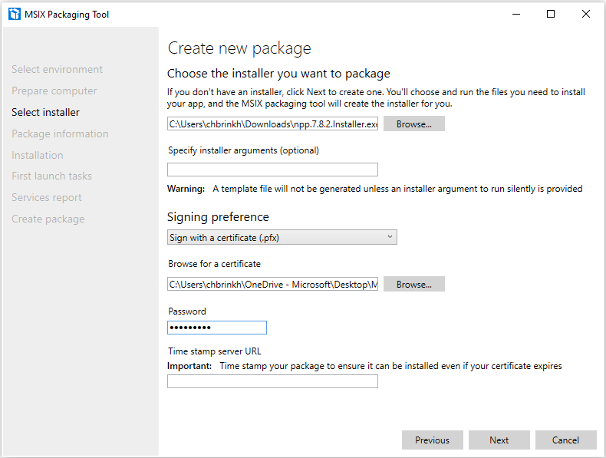
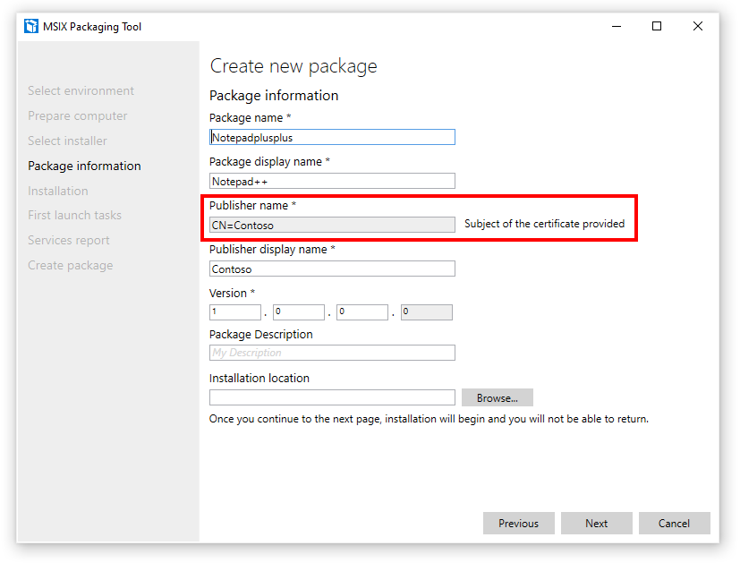
Assign your certificate with the right CN (common name – e.g. Contoso) that we need later. This could be a self-signed certificate as well (for PoC – testing purposes).
Browse for the application installer. This could be any of your win32 applications. For Eg. Notepad ++
The certificate could be self-signed, public or internally created via a RootCA. It’s important that the private key and CN are matching later in the
If the CN is detected correctly, you’ll see the “subject of the certificate provided” notification.

Slide 18
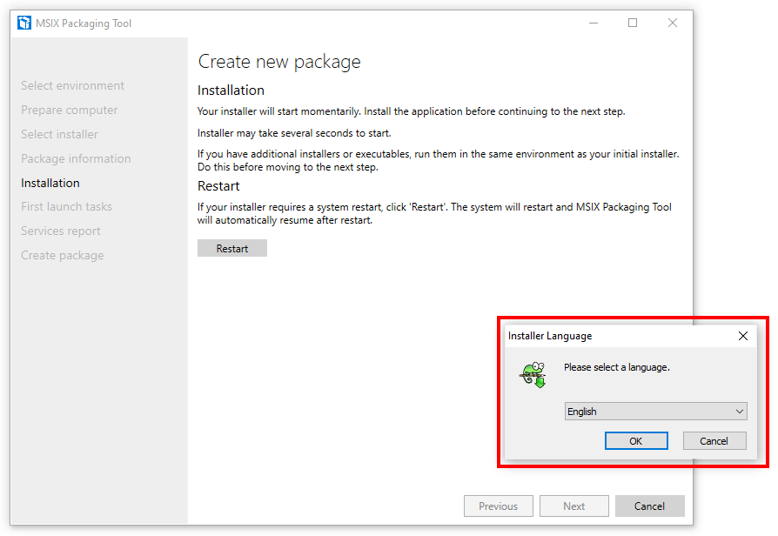
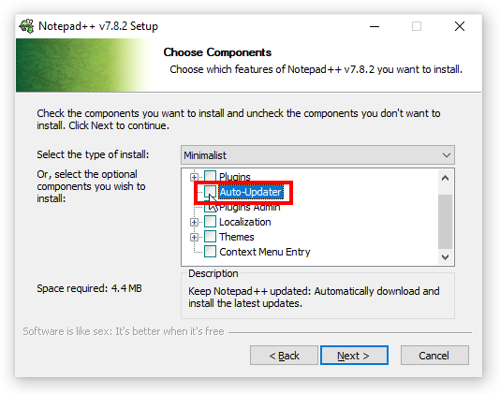
Run through the installation process of your application as in usual manner .
Make sure to disable Auto-update during the installation as the MSIX app attach containers will be read-only.

Slide 19
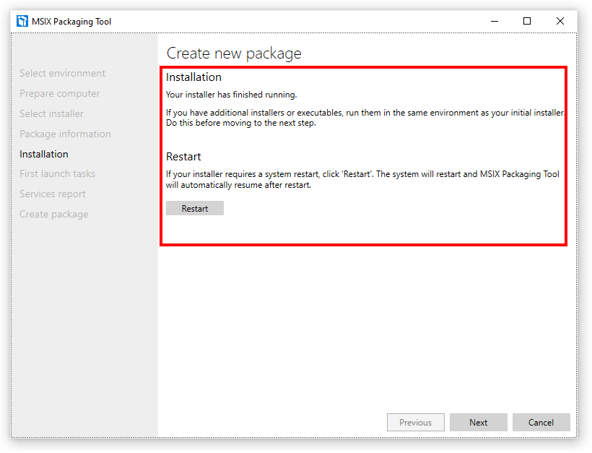
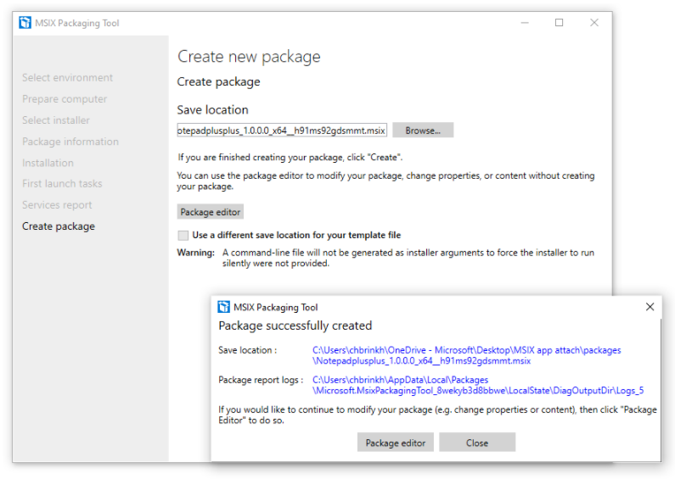
If the application installed correctly, you see the screen below. Make sure to reboot your machine if required before moving to the next step.
Provide the location for package and Click on Create. Once done you will receive this message box on successful creation of package.

Slide 20
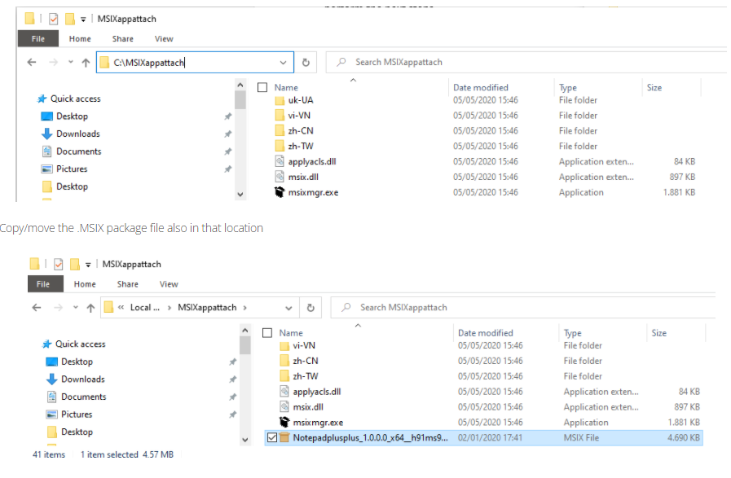
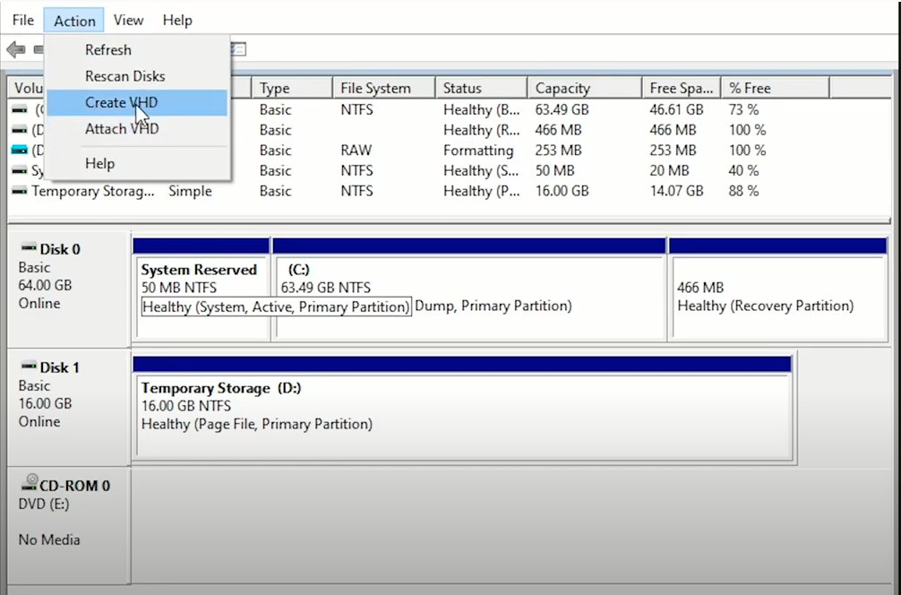
2.Creating VHD & Expanding package in container
Download and install the MSIX mgr tool – this will import the MSIX commands to perform the next steps
Unpack the .zip file to e.g. C:\MSIXappattach.
Also Move the newly created package to the same MSIX mgr tool location just to make pathing a bit easier.
We can create the VHD/X by using Powershell Scripts but Here we are using GUI method to keep things simple using Disk Mgmt . Select action>create VHD

Slide 21
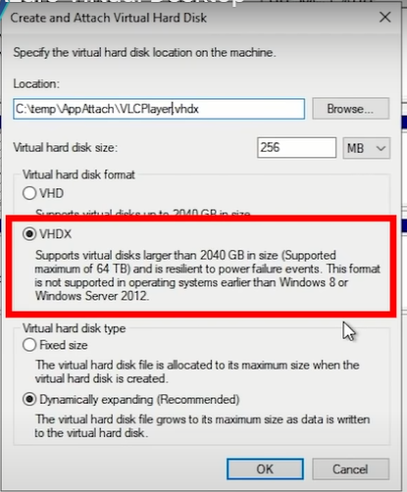
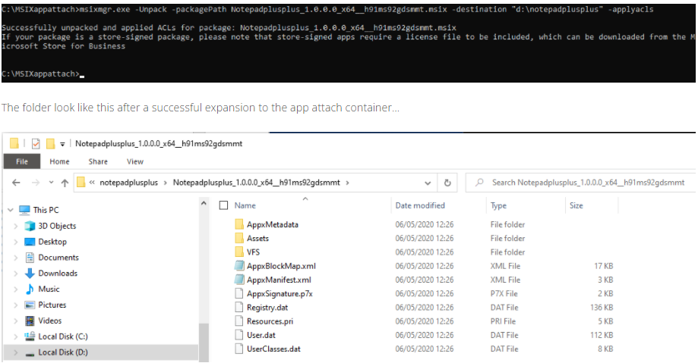
Make sure to choose VHDX as it will limit the VHD size to smallest possible and when new packages are added will expand dynamically.
On next step format the disk in NTFS mode and assign a drive letter.
Create a parent folder on the mounted VHD as its mandatory and MSIX app attach requires it
Run The following command in powershell , it will extract the data from the package and put it into the newly created VHD.
{msixmgr.exe -Unpack -packagePath Notepadplusplus_1.0.0.0_x64__h91ms92gdsmmt.msix -destination "d:\notepadplusplus" -applyacls }
Once Done you will see all the files like User.dat (contains synced user data ), Registry.dat (contains virtual registry) . VFS folder is main folder which contains the application.
Now Detach the vhd disk . It will become available in your Local file system which can now be copied upto the fileshare which we are going to use.

Slide 22
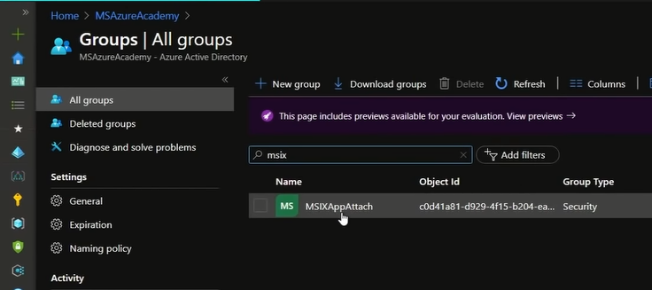
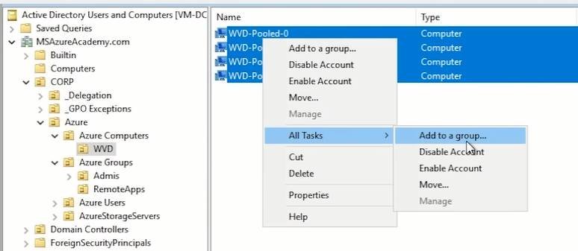
3.Azure File and NTFS permissions to App-attach
Process overview for authorizing computer accounts for Azure fileshare
1. Create AD DS security group.
2. Add the computer accounts for all session hosts as members of the group
3. Sync AD DS group to Azure AD
4. Create storage account
5. Create file share under the storage account
6. Join storage account to AD DS
7. Assign the AD DS group that has been synched to Azure AD, the Storage File Data SMB Share Contributor role assignment on the storage account
8. Mount file share on any session host
9. Grant NTFS permissions on the file share to the AD DS group
In Active Directory , we need a group which is being synced by Azure AD connect ,like here we have CORP OU
Locate the session hosts on AD and select all >right click>All Task>Add to a group >Enter group name(here MSIX app attach) that is already on azure AD and allow at least 30 minutes to sync.
Note:The Storage account should be added to Domain controller and It also should be synced to Azure AD as well

Slide 23
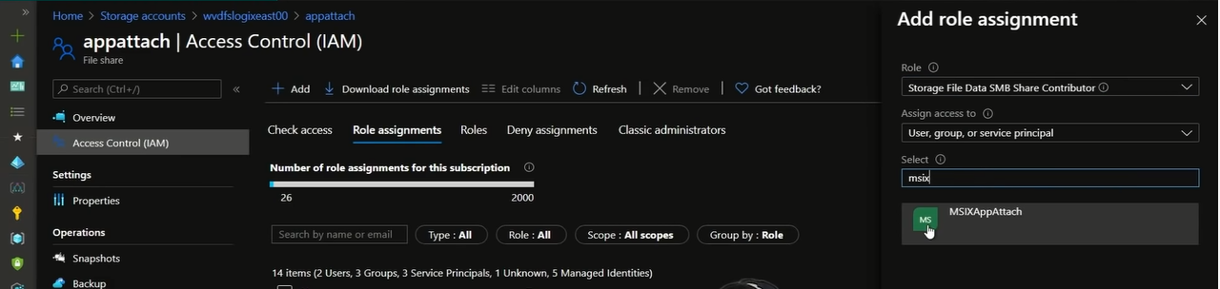
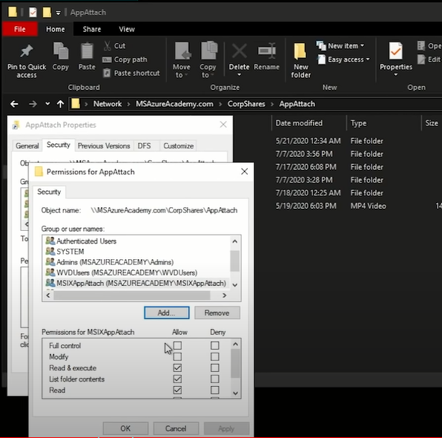
We will need SMB File share Contributor role for the Group that we have chosen.(In this case named - MSIX app attach)
NTFS File permissions to appAttach
Go back to your server and right click on your file share folder and go to properties >security tab >and type in Group name that needs permission .(Here named- MSIX app attach) .
Apply “Read and execute” permission and that’s all you need.
Here we are giving read permissions to the MSIX app attach group on this file share folder.

Slide 24
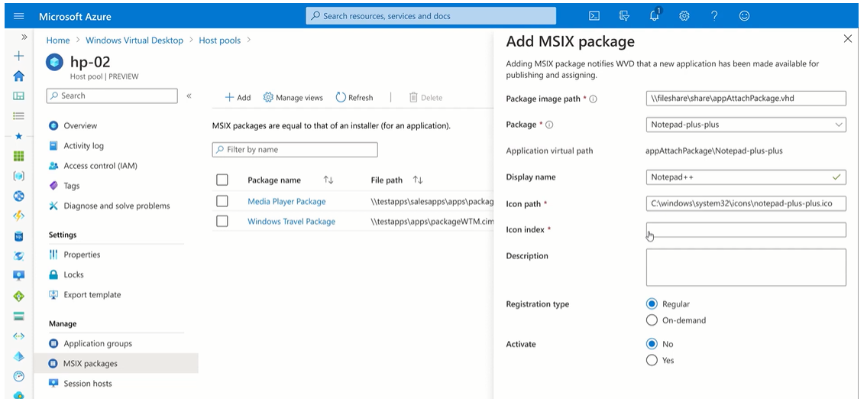
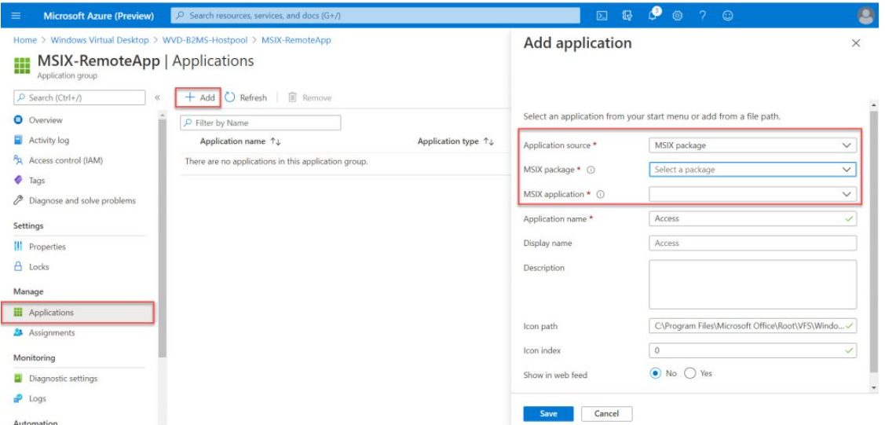
4.Adding the Package to Hostpool
Select Hostpool required. >click msix package >click add .
Put the UNC path for the virtual hard drive.
When you put the UNC path , the certificate and the computer permission to the share would be verified and MSIX container will be inflated .
After choosing UNC path , you will be able to see the list of application available in the VHD drive ,choose the required one and give a display name.
5.Assign package to Application Group
Application group.>click add >application source = MSIX package
Then choose the package and the application as well and apply.

Slide 25
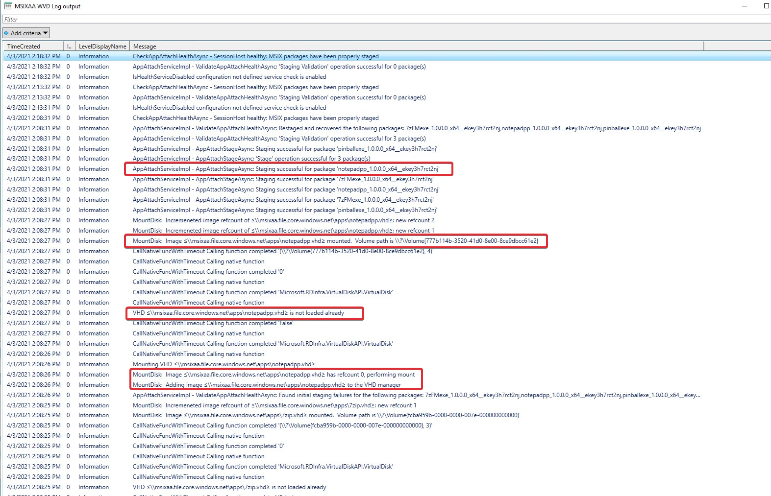
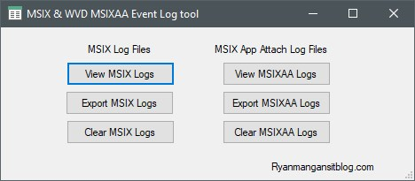
Troubleshooting tool for MSIX log files and app attach files

Slide 26
References & links
For Configuration step by step
https://www.christiaanbrinkhoff.com/2020/12/02/the-future-of-application-virtualization-learn-here-how-to-create-and-configure-msix-app-attach-packages-containers-on-windows-10-enterprise-multi-and-single-session-build-2004-and-higher-for-win/#Howdoestheprocessworks.
Video tutorials –
https://ryanmangansitblog.com/2020/08/20/a-deep-dive-into-msix-app-attach-windows-virtual-desktop/#:~:text=Introduction%20Microsoft%20announced%20the%20general,the%2013th%20of%20April%202021.
For troubleshooting App attach-https://github.com/stgeorgi/msixappattach/blob/master/Troubleshooting%20methedology%20v2.pdf
For Troubleshooting MSIX file.
-https://github.com/microsoft/msixpackaging/blob/master/src/inc/public/MsixErrors.hpp
MSIX event logs tool-
https://github.com/RMITBLOG/MSIX_APP_ATTACH/tree/master/MSIX%20Event%20Log%20tool
How Azure File shares work - https://docs.microsoft.com/en-us/azure/storage/files/storage-files-active-directory-overview#how-it-works
How to Setup Azure Files : https://techcommunity.microsoft.com/t5/azure-virtual-desktop/step-by-step-guide-on-computer-account-auth-for-azure-files/m-p/1855164#M5721

Slide 27
Thank you

